Slide 1


Interactive Model of a Quantum Computer
@ Fascinating Informatics by SJF, September 2021
15.11.2021
Matias Betschen & Tommaso Peduzzi
Supervised by:
Valentin Bamert and Henrique Säuberli
Notes:
As in the opening slide, the acknoledgements are suitable for pictures or jokes which do not belong to the main part.

Slide 2
Our Experience
Task was given, but we were free to elaborate on it
Got a small intro into QC at the beginning of the week
Normally in Altstetten, at the end of the week went to the lab
All in all really enjoyable experience!

Slide 3
Our task
To create a Virtual-Reality-Experience for people to be able to interact with a quantum computer and learn what each part does without any prior knowledge.
Parts of the “fridge” of a quantum computer Image courtesy of IBM

Slide 4
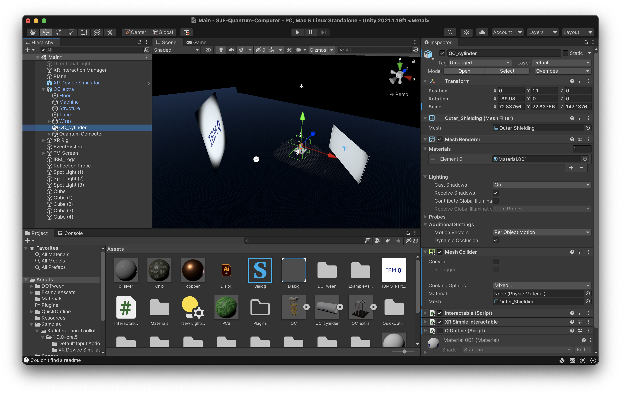
Our workflow
Tools:
Unity
Blender
HTC Vive
Went to the lab at the end of the week
Weren‘t able to finish completely
Notes:
Maybe mention that we were given some ressources and that the tutors helped us.

Slide 5
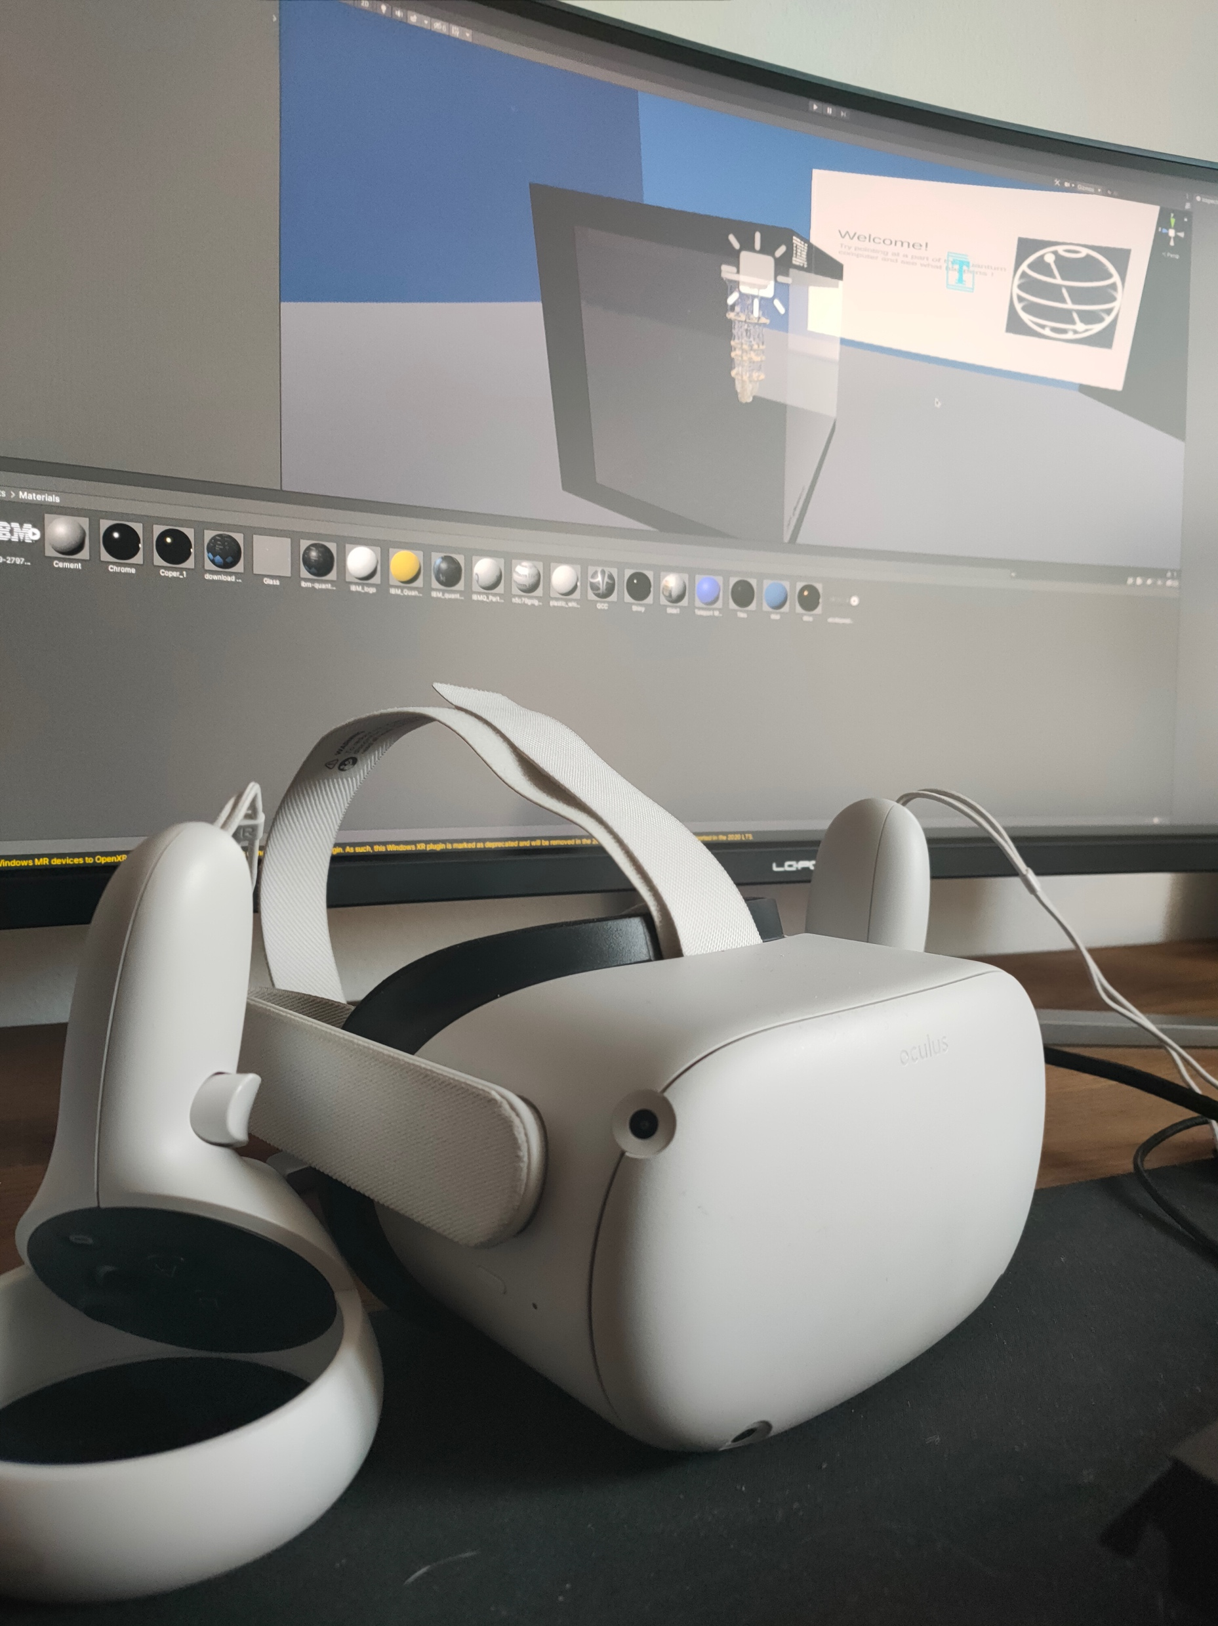
Further Development
Bought our own VR-Headsets
Added movement
New Model
Better lighting
Better information

Slide 6
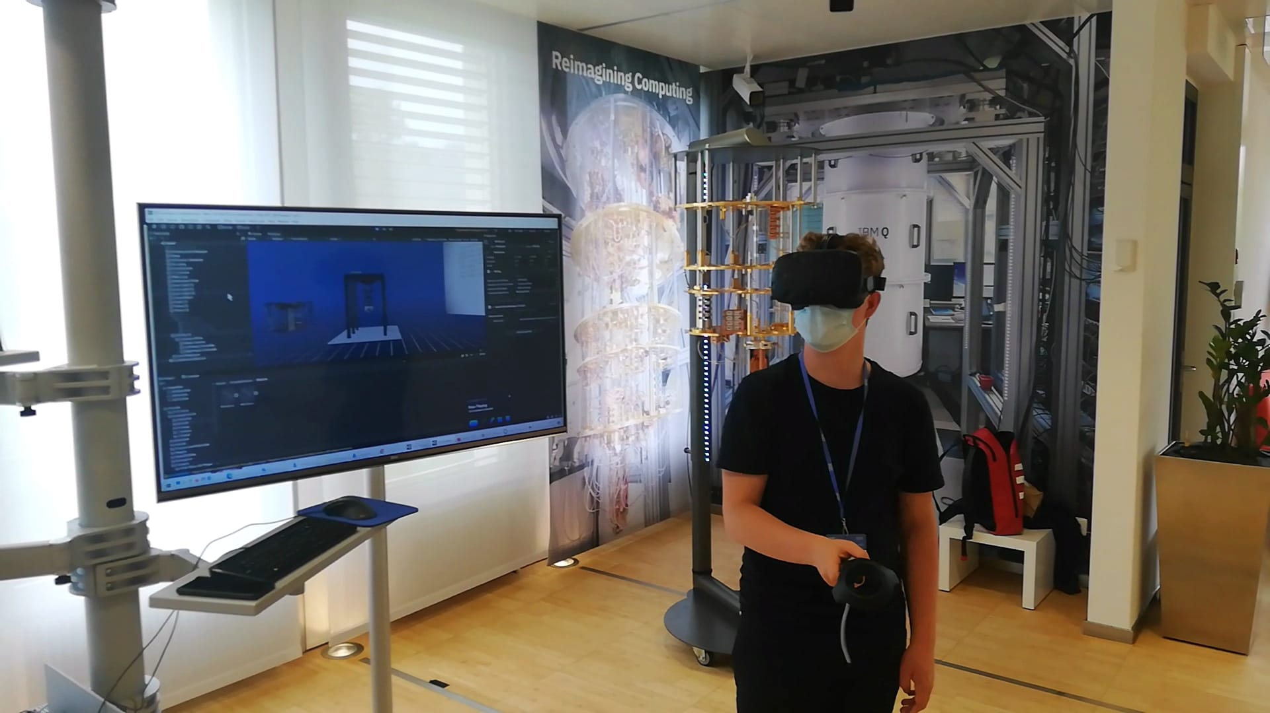
Conclusion & Demo
Gives Clients an important insight into quantum computers
Easy to use and intuitive

Slide 7
Acknowledgements
Thanks to Schweizer Jugend Forscht and IBM for this opportunity.
Thanks to the Hasler Stiftung for sponsoring.
Thanks to Dr. Victor Varga from SJF and Valentin Bamer from IBM for the organization.
Thanks to Henrique Säuberli, Nadim Ritter, Radu Stingaciu and Calvin Limat for the tutoring!

